Slide 1

Light Detection Alarm
Submitted to:
Prof.Pradeep Kumar
Submitted by:
Nagaboina Dharsini EN22AM0036
Sahana Priya ENG22AM0050
Sana Banu ENG22AM0053
Pooja ENG22AM1002

Slide 2

Abstract
Objective
Design and implement a light detection alarm system using an Arduino Uno.
Components:
Light sensor (potentiometer)
LED for alarm
Push button for reset
Operation:
Monitors ambient light levels.
Activates alarm (LED) when light exceeds threshold.
Manual reset with push button.
Applications:
Security enhancement.
Maintains optimal light in labs and galleries.
Features:
Real-time monitoring.
Simple, cost-effective, and easy to implement.
-

Slide 3

Problem Statement
Need:
Automated system to maintain appropriate light levels in security-sensitive areas and energy-efficient spaces, addressing inefficiencies and errors of manual monitoring.
Challenges
Continuous monitoring of ambient light, providing real-time alerts when levels exceed or fall below thresholds, and incorporating a manual reset function.
Solution
Design a light detection alarm system using Arduino Uno to detect light intensity changes, trigger alarms, and ensure efficient, real-time light management.

Slide 4

Introduction
Develop a light detection alarm system using Arduino Uno.
Monitor light levels and trigger an alarm when intensity exceeds a threshold.
Components: light sensor (potentiometer), LED for alarm, and push button for reset.
Applications: security, labs, galleries, and energy-efficient spaces.
Features: real-time monitoring, immediate response, manual reset.
Educational: practical integration of sensors and microcontrollers.

Slide 5
Components
Arduino Uno: Microcontroller board
Light Sensor : Simulates varying light intensities
LED: Indicates the alarm state
Push Button: Resets the alarm
Resistors: Ensures proper current flow
Breadboard and Jumper Wires: For connecting components
Power Source: Supplies power to the Arduino board

Slide 6

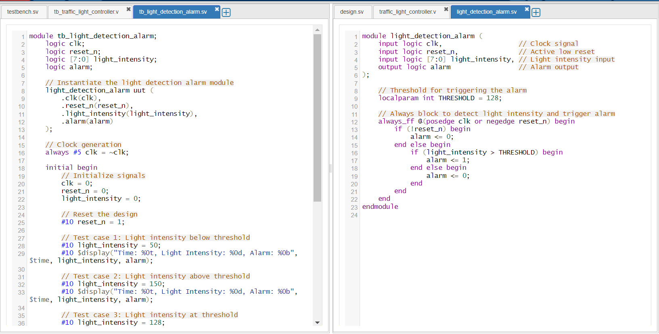
Code

Slide 7
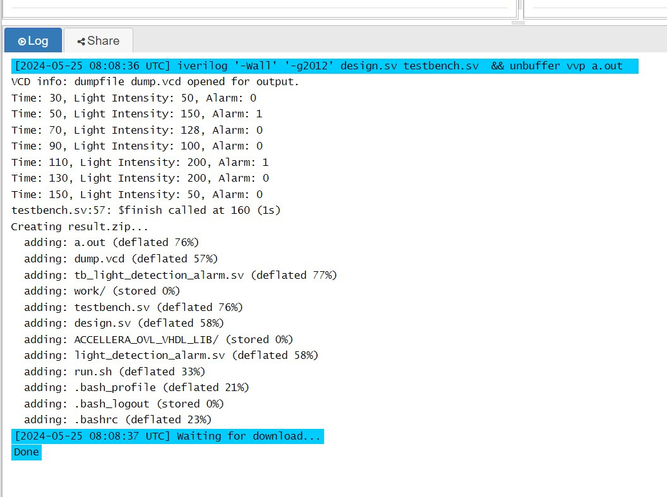
Implementation

Slide 8
Conclusion
Successful Implementation
Developed a functional light detection alarm system using Arduino Uno.
Real-Time Monitoring
Achieved continuous monitoring of ambient light levels.
Effective Alert System
Triggered alarms accurately when light intensity exceeded thresholds.
User Control Incorporated a manual reset function for ease of use.
Practical Applications
Suitable for enhancing security and maintaining optimal light conditions in various settings.

